Slide 1

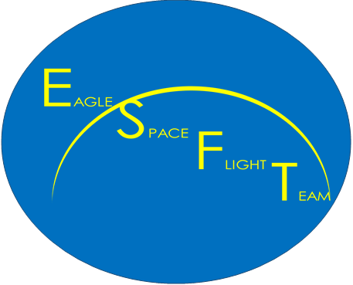


Eagle Space Flight Team A Student Team’s Plan to Fly a Rocket to Space
Bryce Chanes - Founder and Project Manager
ChanesB@erau.edu
Mentor: Dr. Jacob Zwick

Slide 2

Outline
The Team
OCRs
Objectives
Future Progress

Slide 3
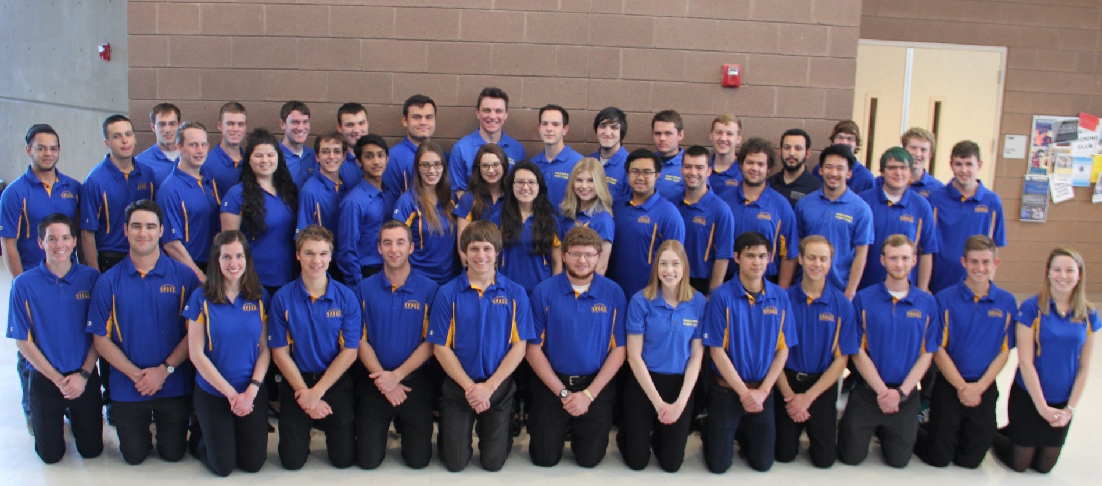
The Team

Slide 4
Team Leadership
Project Manager
Electronics Team Lead
Propulsion Team Lead
Structures Team Lead
Communications Team Lead
Faculty Advisor
Aerodynamics Team Lead

Slide 5
Team Leadership
Project Manager
Electronics Team Lead
Propulsion Team Lead
Structures Team Lead
Communications Team Lead
Faculty Advisor
Assistant Project Manager
Aerodynamics Team Lead

Slide 6
Project Structure
SpaceShotOne
Electronics
Propulsion
Structures
Communications
Aerodynamics

Slide 7
What is an OCR?
Integral part of the Systems-Engineering approach
Objectives
Constraints
Requirements
Help to define steps toward mission
Allows for easier milestone tracking

Slide 8
Primary Objectives
The apogee of SpaceShotOne should be greater than 100 kilometers above mean sea level.
SpaceShotOne should transmit positional data during the mission.
SpaceShotOne should store positional data during the mission.
SpaceShotOne should transport less than 10 kilograms of payload.
50 percent of SpaceShotOne’s inert mass, not including payload, should be reusable.

Slide 9
Secondary Objective
75 percent of SpaceShotOne’s inert mass, not including payload, should be reusable.

Slide 10
Tertiary Objectives
SpaceShotOne should be the first student-designed and built rocket to fly over 100 kilometers above mean sea level.
90 percent of SpaceShotOne’s inert mass, not including payload, should be reusable.
SpaceShotOne should be fully validated by summer of 2020 .

Slide 11
Acknowledgements
Dr. Jacob Zwick – Project Mentor
Dr. Gary Yale – ERAU Space Grant Coordinator

Slide 12
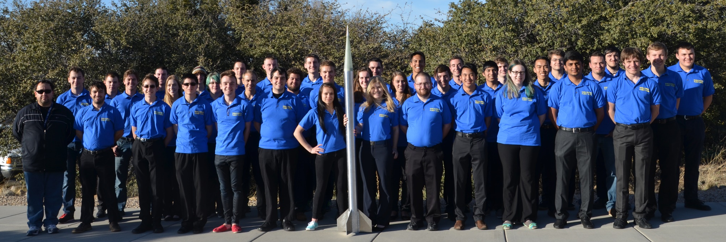
Questions?
Electronics Team Lead:
Bryce Chanes
ChanesB@erau.edu
Learn more about the Eagle Space Flight Team:
www.EagleSpaceFlightTeam.com
www.facebook.com/eaglespaceft/
EagleSpaceFlightTeam@gmail.com

